Slide 1
Status Report #14
Midterm presentation of B4 thesis
ToF: Cosmic-ray
ToF: Beam time data analysis
2020. Feb 13 (Thu)
B4 FUJIWARA Tomomasa

Slide 2
ToF: Cosmic-ray
Check: Bias dependence, cable length dependence
Bias: taking 3 points
→ 41.7V, 44.7V, 47.7V: +0.0V, +3.0V, +6.0V (from V_{op} = 41.7 V)
cable length: taking 6 points
→ initial, +6 ns, +12 ns, +16 ns, +48ns, +80ns (Bias: fixed at +3.0 V)

Slide 3
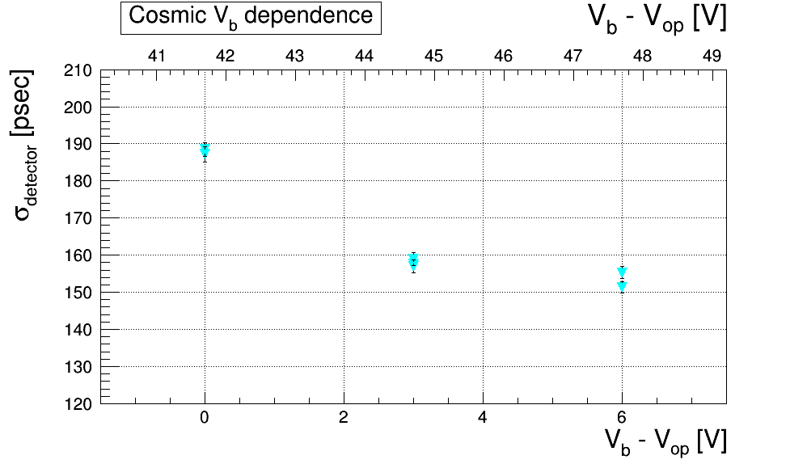
ToF: Cosmic-ray –Result-
Result: Bias dependence

Slide 4
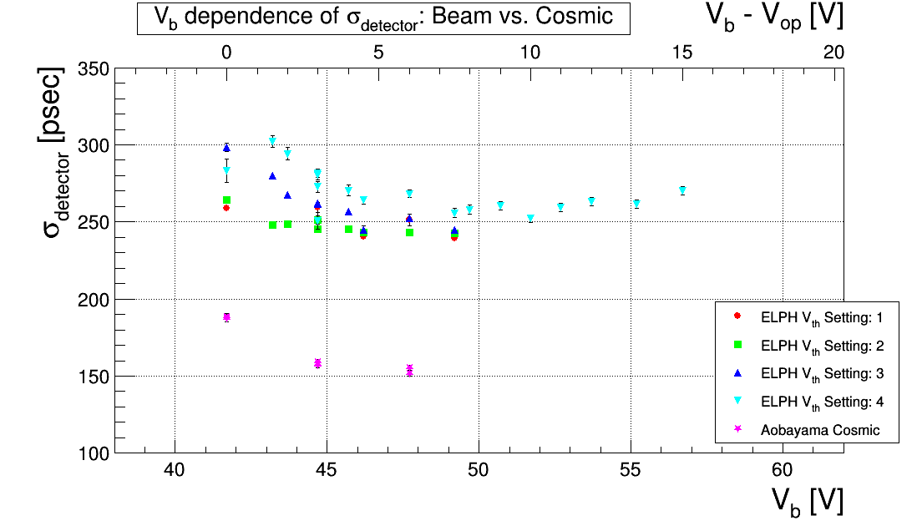
ToF: Cosmic-ray –Result-
Comparison to data at ELPH

Slide 5
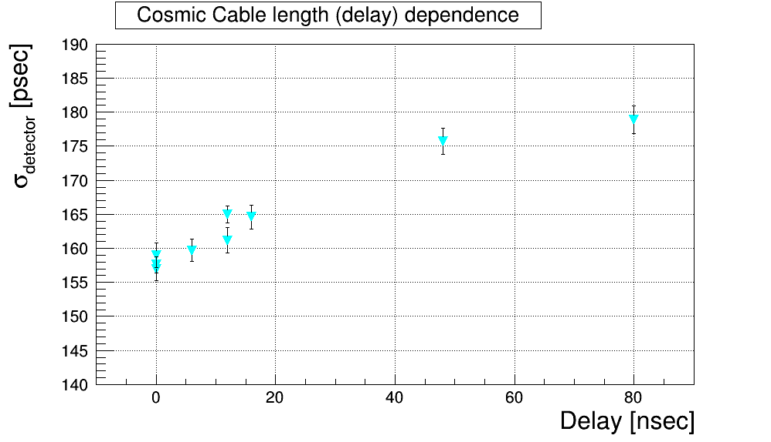
ToF: Cosmic-ray –Result-
Result: Cable dependence
Initial

Slide 6
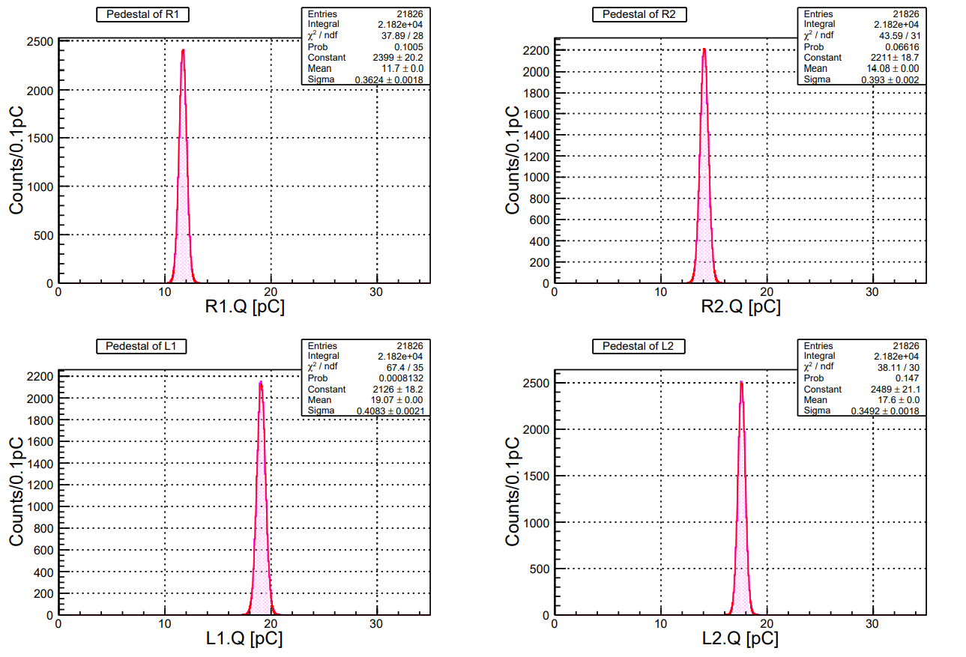
ToF: Cosmic-ray –Pedestal-
Width: Typically ~4ch

Slide 7
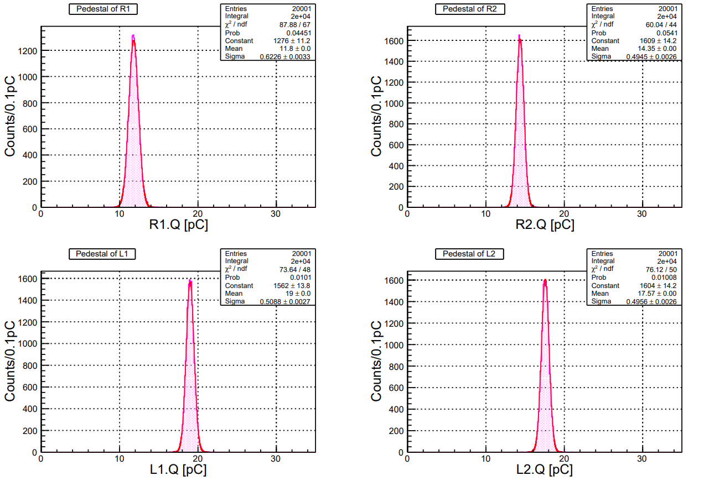
ToF: Cosmic-ray –Pedestal-
At + 80 ns delay
Width: ~5 - 6 CH

Slide 8
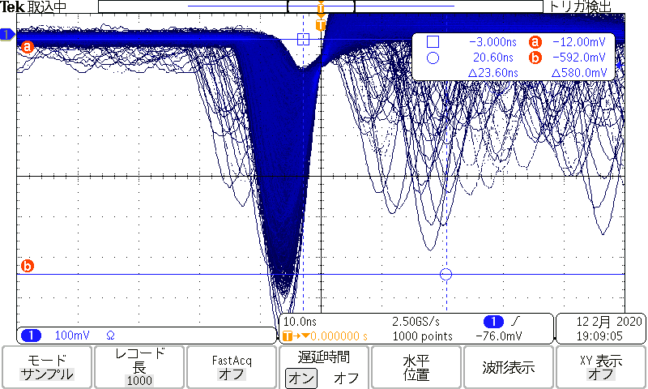
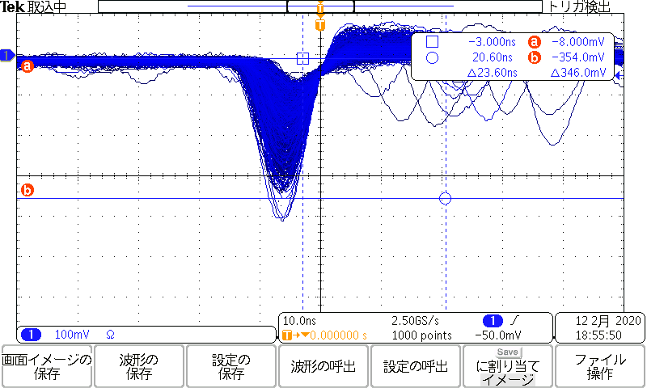
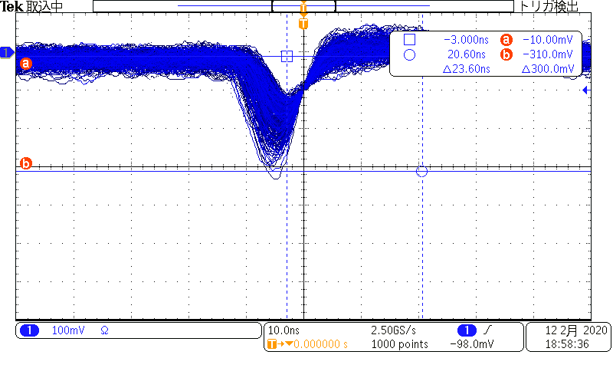
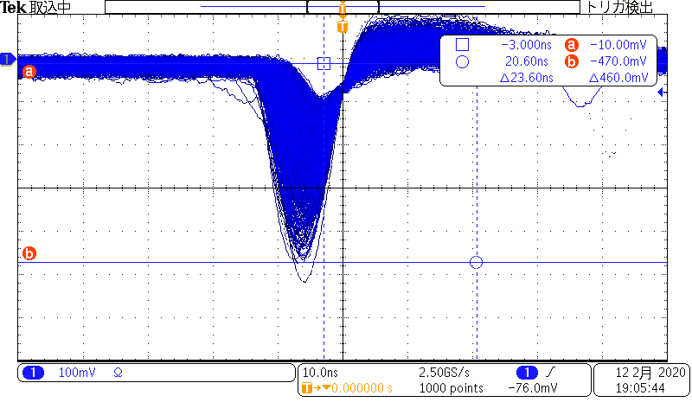
ToF: Cosmic-ray
Check gain using β-ray source
R-1 -580mV
R-2 -340mV
100 mV
10.0 nsec
L-1 -350mV
L-2 -460mV

Slide 9
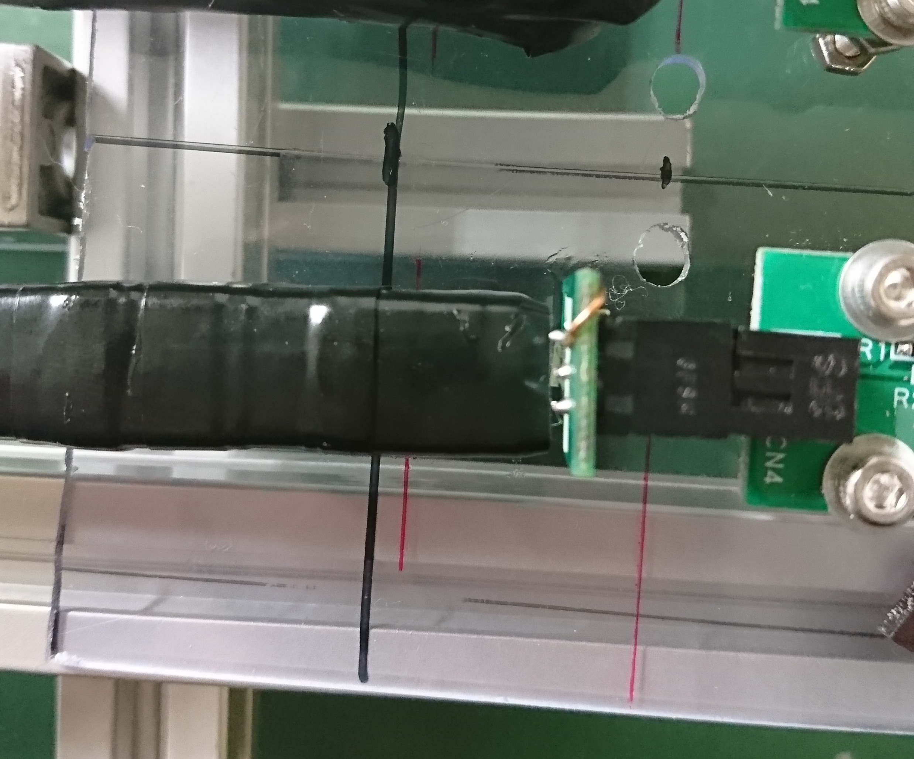
ToF: Cosmic-ray –connection between scintillator to MPPC-
Unmounted scintillator & MPPC → Mount scintillators staggered 2~3mm

Slide 10
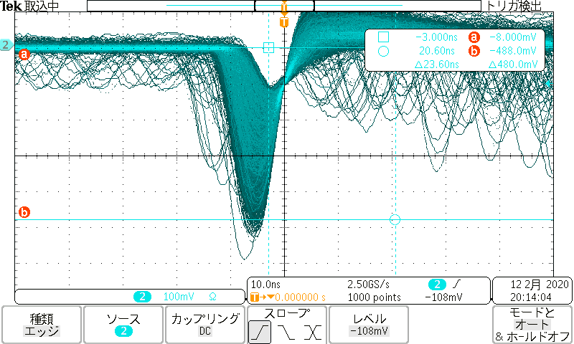
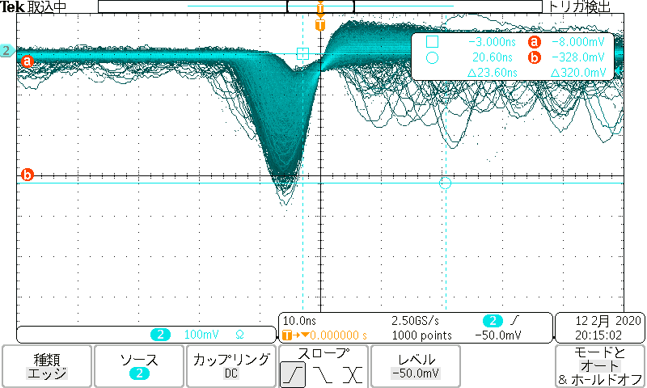
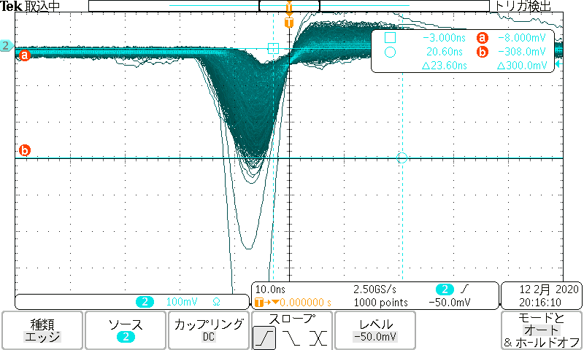
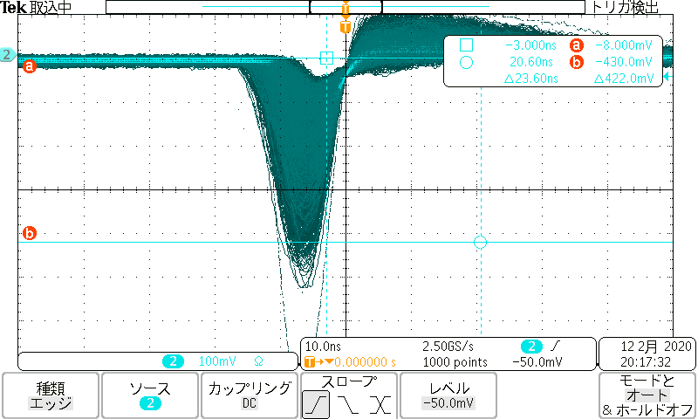
ToF: Cosmic-ray –connection between scintillator to MPPC-
Unmounted scintillator & MPPC → Mount scintillators staggered 2~3mm
Check gain using β-ray source
R-1 -480mV
R-2 -320mV
100 mV
10.0 nsec
L-1 -300mV
L-2 -420mV

Slide 11
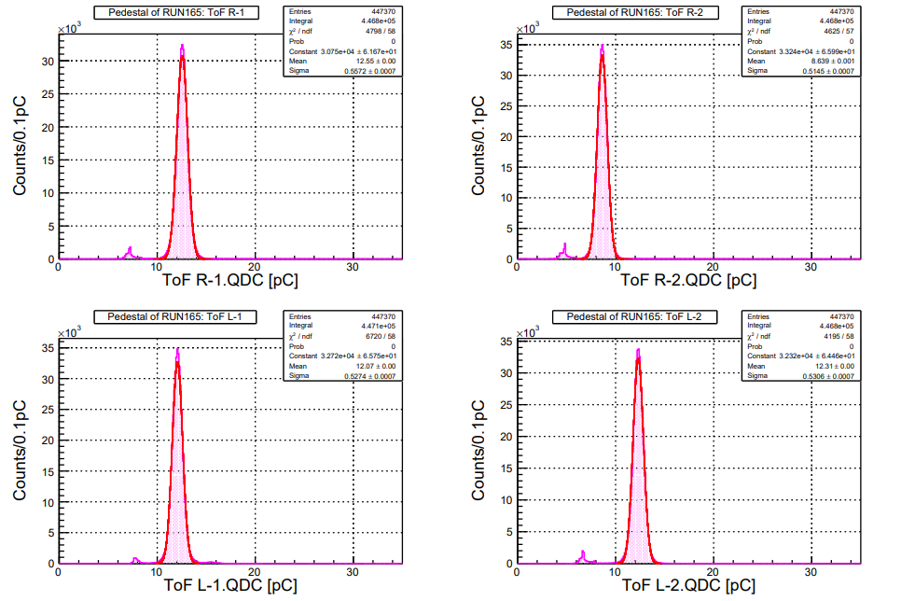
ToF: Beam time data analysis
Checked Pedestal distribution for V_{b}=44.7 V run
Pedestal dist. = QDC with TDC ≦ 0 at all readout
For run165
Decision of pedestal value
*Fit with gaussian → μ = pedestal
σ = width

Slide 12
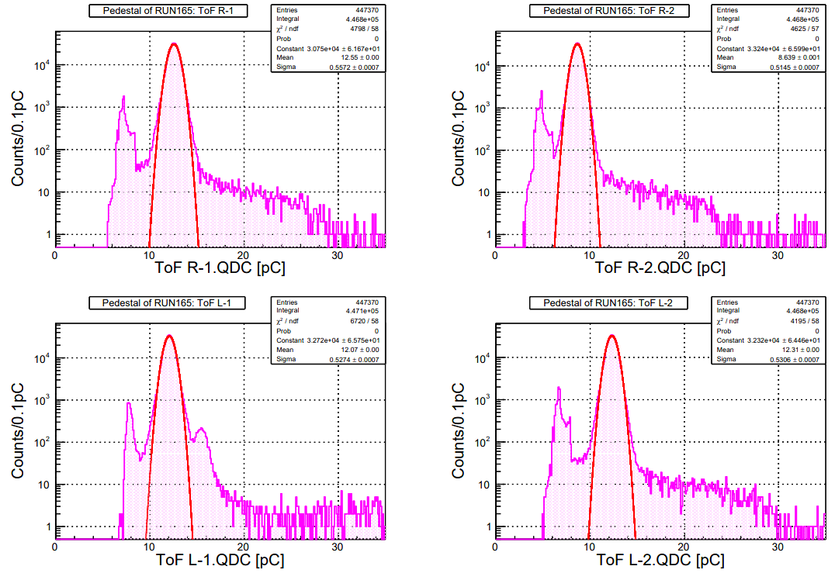
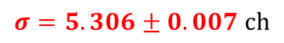
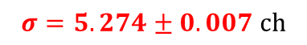
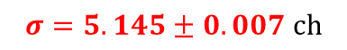
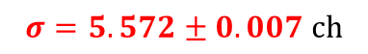
Pedestal dist. of run0165 in log scale
In log scale
There are tale distribution
$$σ=5.572±0.007 ch$$
$$σ=5.145±0.007 ch$$
$$σ=5.274±0.007 ch$$
$$σ=5.306±0.007 ch$$

Slide 13
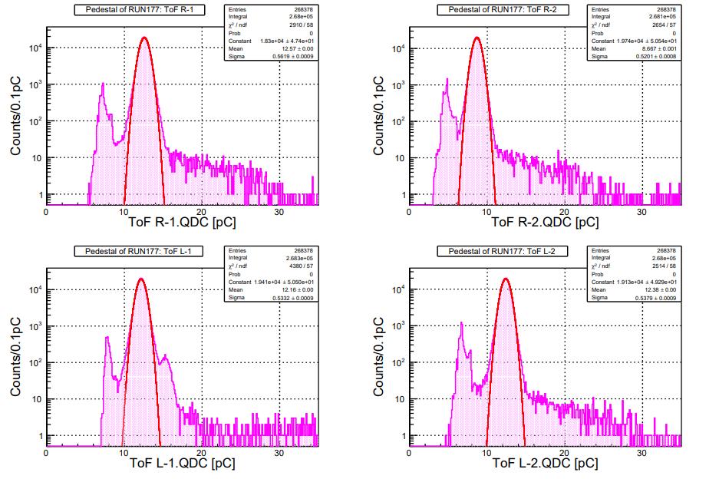
Pedestal dist. of run0177
run0177

Slide 14
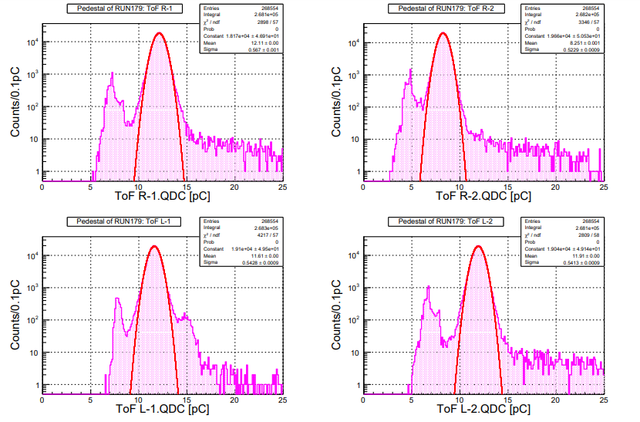
Pedestal dist. of run0179
run0179

Slide 15
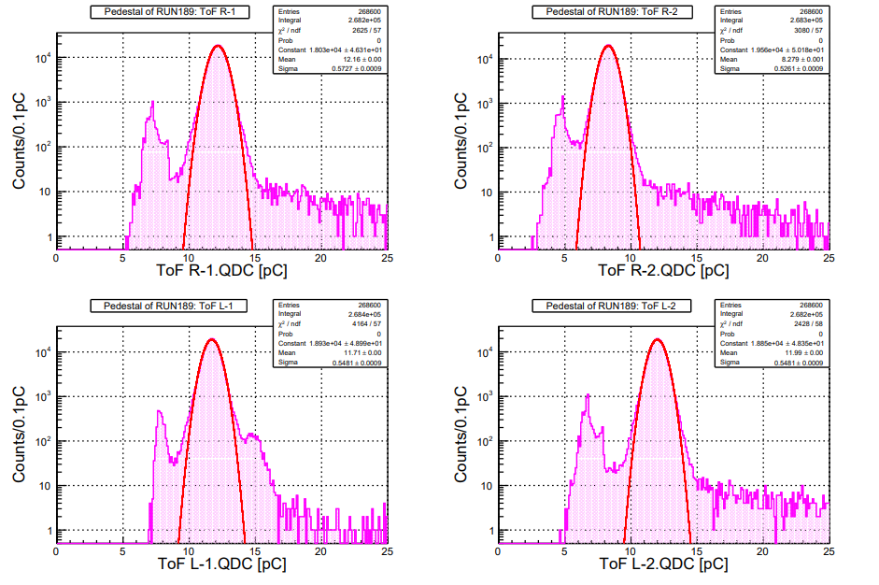
Pedestal dist. of run0189
Run0189
For each run, width~5ch

Slide 16
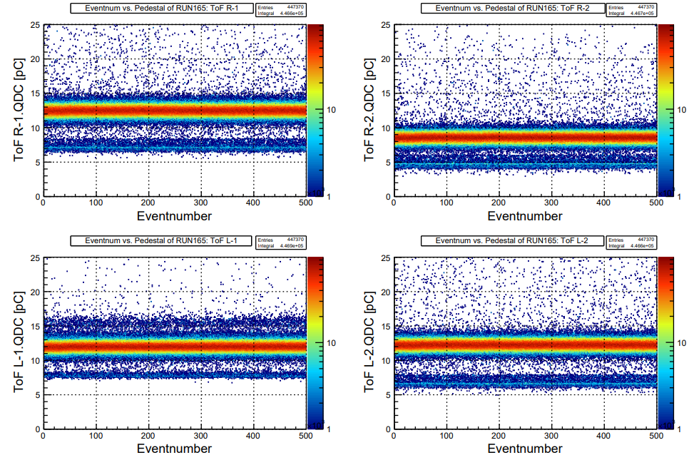
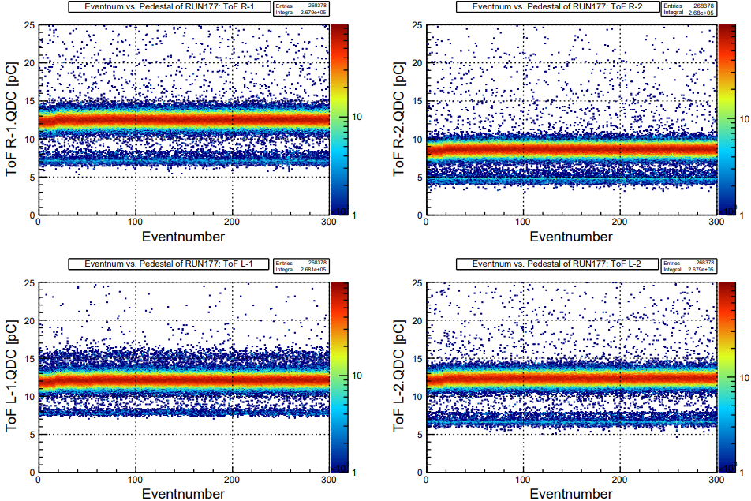
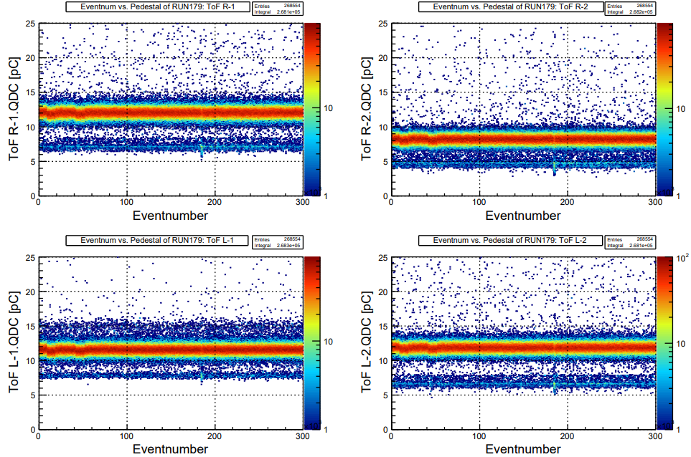
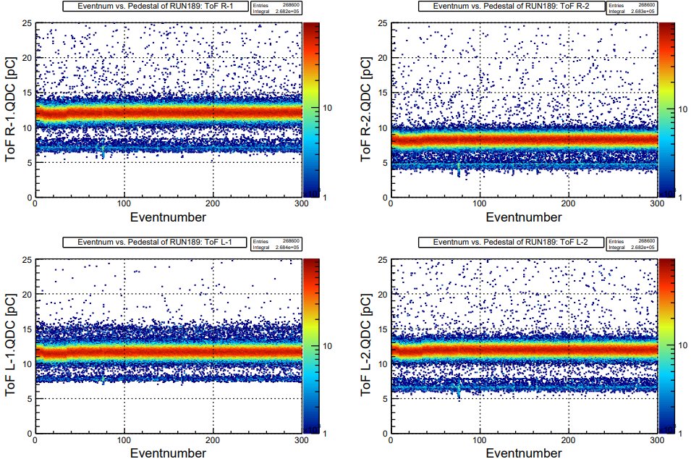
Pedestal vs. Event num.
Only R-1 for simplicity
in 177, 179 and 189
→ strange structure.

Slide 17
To do next
ToF: continue to taking data with cosmic
Circuit design: learning CAD

Slide 18
Back up

Slide 19


Slide 20
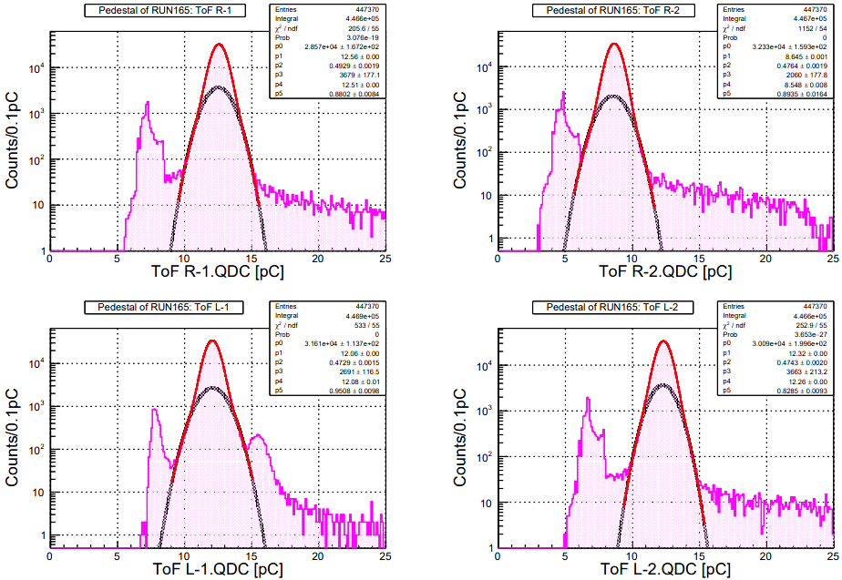
Pedestal dist. of run0165
Fit with double-gaussian
Subtly not to work out fitting...

Slide 22
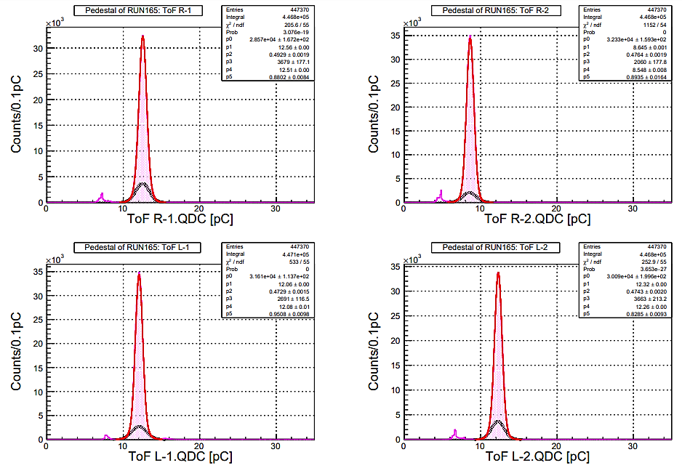

Slide 23
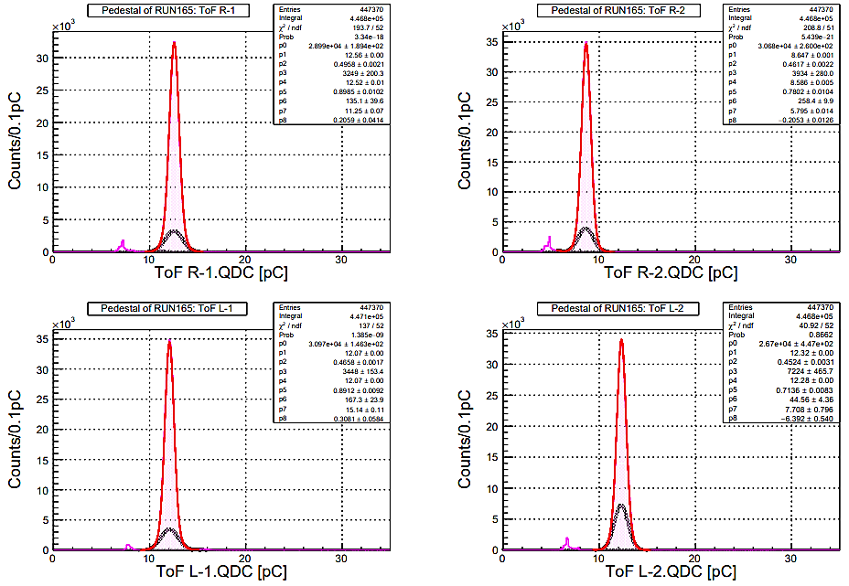

Slide 24
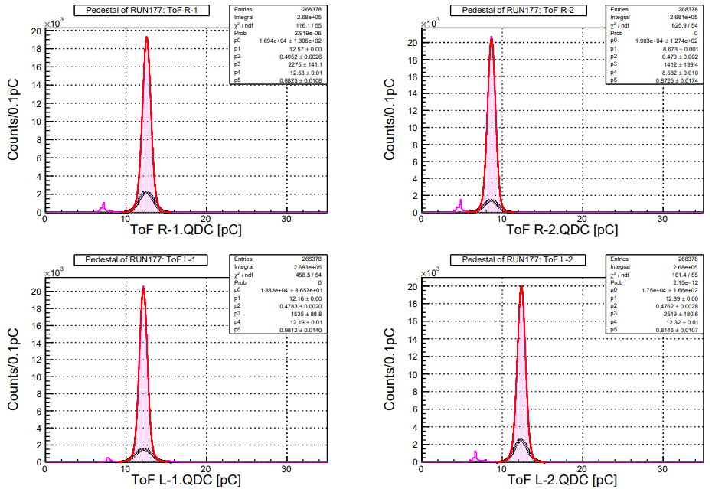

Slide 25
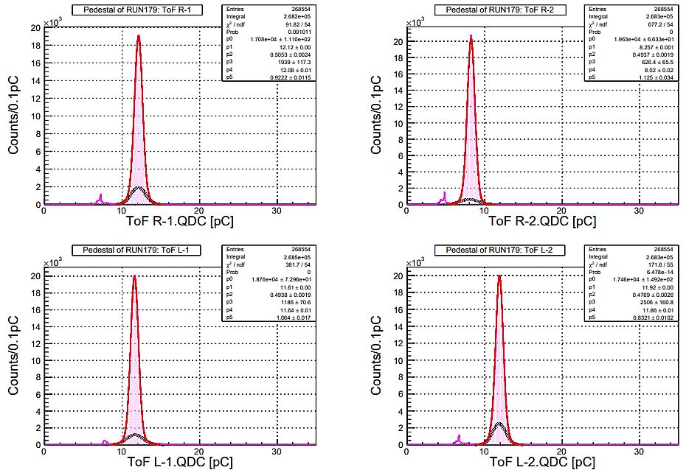

Slide 26
